Slide 1

RUMYPET(R U my pet?)
Team Groza
Kim Tae Hong (20132335)
Kim Chan Il (20150577)
(Presenter) Paeng Jin Wook (20154645)
Notes:
Hello everyone, we’re team Groza.
I’m a presenter 팽진욱

Slide 2
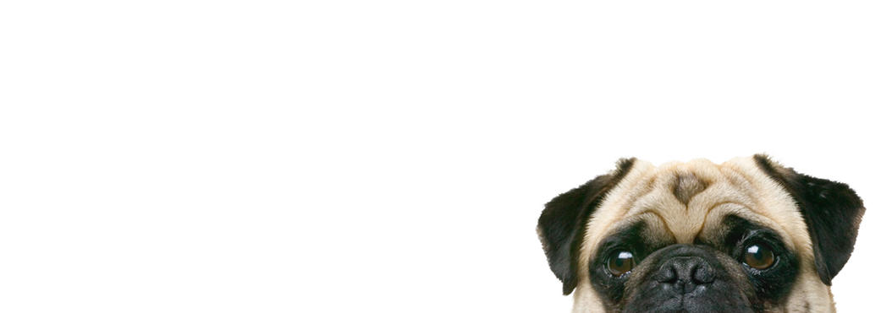
Contents
Schedule & Progress
Problems & Solutions
Plans
Q&A

Slide 3
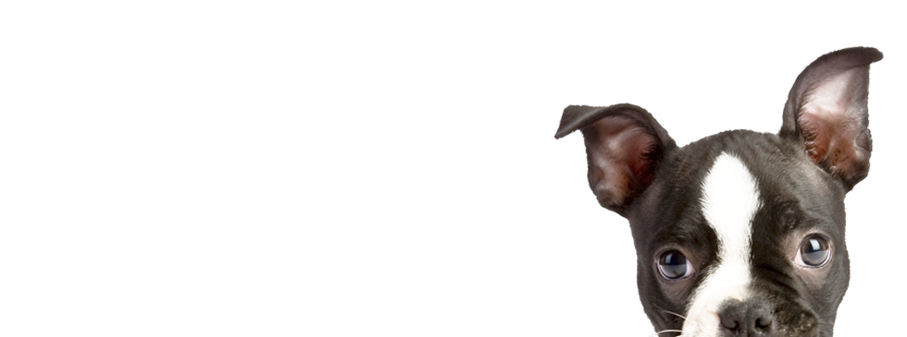
1. SCHEDULE & PROGRESS

Slide 4
SCHEDULE
Week | To-Do (can be changed)
Week 1 | Project goal setting
Week 2 | Propose project
Week 3 | Design: User Interface, System Architectures Setting : Development Environment,
Week 4 | Workshop for collecting data set( Dog cafe, park, .. etc)
Week 5 | Hong : developing AWS server environment. Paeng : preprocessing the dog’s nose picture using opencv. Chan : developing basic UI in application.
Week 6 | Hong : complete the developing basic Server Core Paeng : use various algorithms, confirm the each algorithm’s effect Chan : collect various data set
Week 7 | Hong : connect the server and application Paeng : connect the server and application Chan : develop the UI and database
Week 8 | Midterm Examination
4
Notes:
This is our schedule.
This week, we’re supposed to go workshop to collect the data of dog nose.
Because we don’t have any data.

Slide 5
Week 9 |  | Hong : sync with server Paeng : sync with client Chan : Intermediate check of our development status
Week 10 |  | Hong : complete the server and android application. Paeng : complete the Application UI Chan : complete the algorithm.
Week 11 |  | We will meet together and feedback each other’s code.
Week 12 |  | Hong : Implement improvement factor at Server Paeng : Implement improvement factor at algorithm Chan : Implement improvement factor at application UI
Week 13 |  | First Demonstration and feedback
Week 14 |  | First Revising our project
Week 15 |  | Final Demonstration
Week 16 |  | Final Examination
SCHEDULE
5
Notes:
This is the schedule later.

Slide 6
Role of this week
Week 4 | Kim Chan Il : Apply Design in Android Studio Kim Tae Hong : Launch Server Using Amazon Web Service Paeng Jin Wook : Develop Pre-processing Method
Week 4 | Workshop for collecting data set ( Dog cafe, park, .. etc)
6
Notes:
As I said, we’re supposed to go workshop to collect some data.
But, It is so simple, We don’t want you to blame me.
*So we did some extra works.
--ppt read--
We will gonna show you the modified schedule next week.

Slide 7

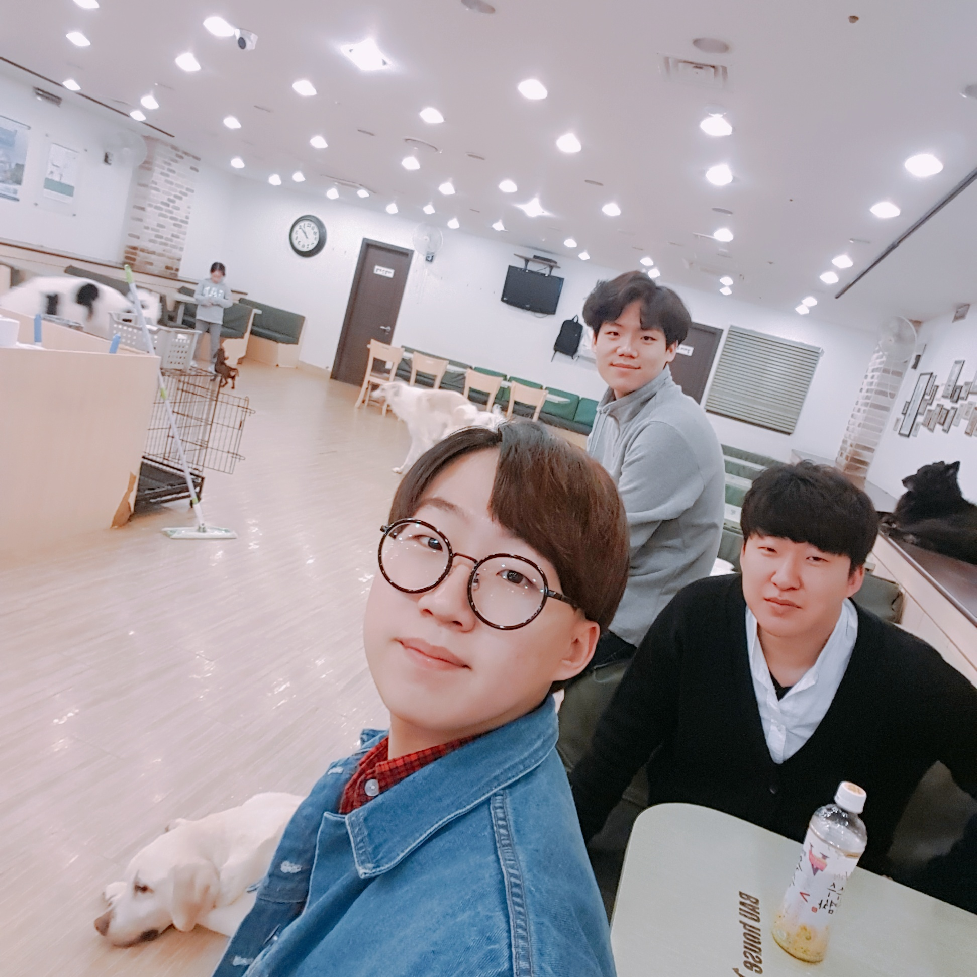
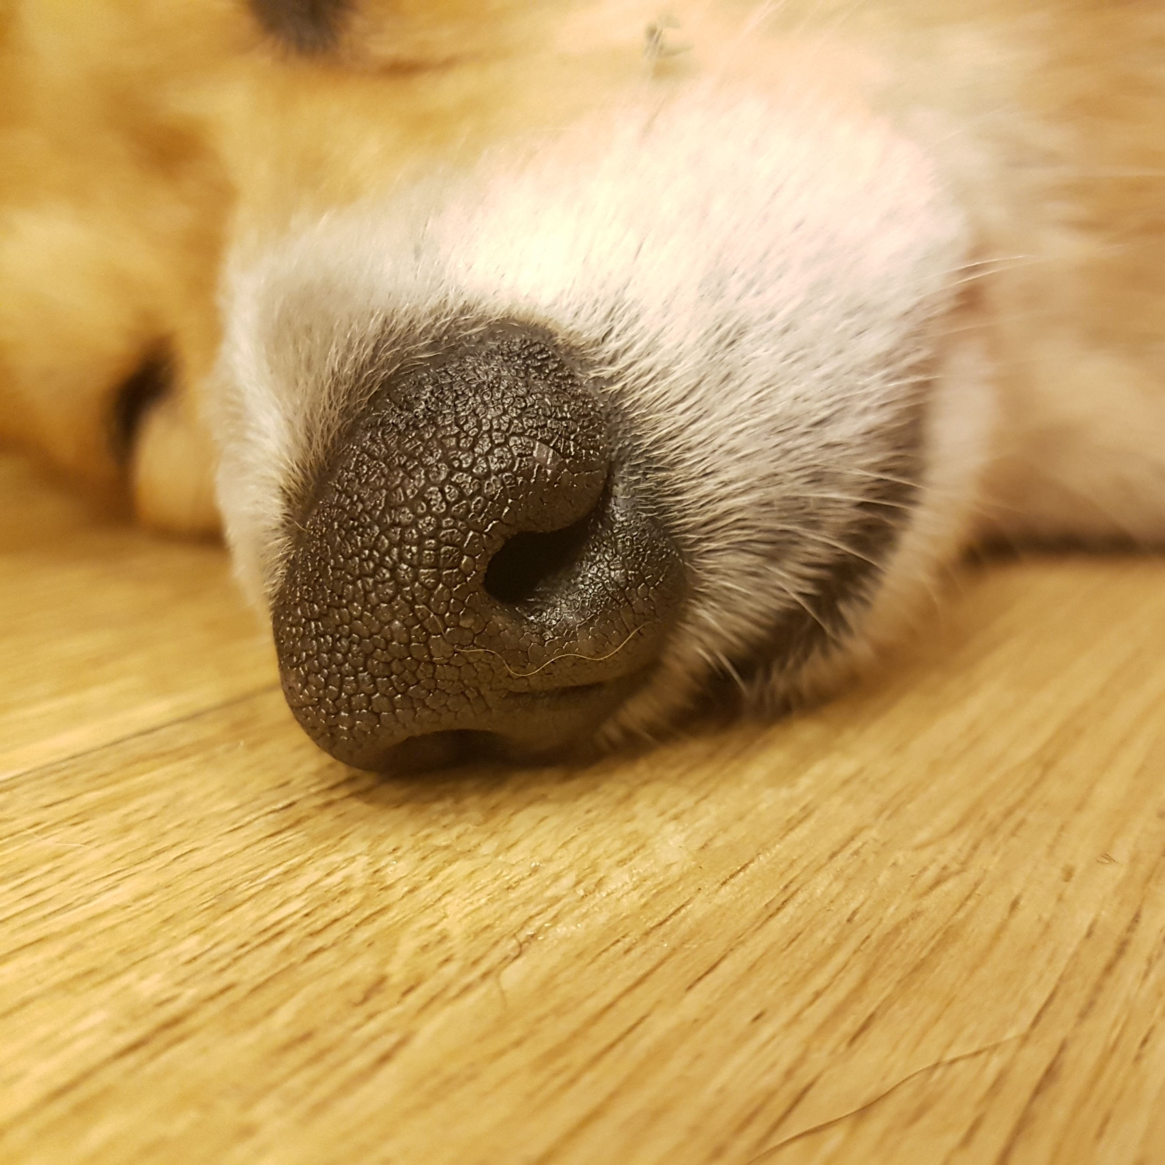
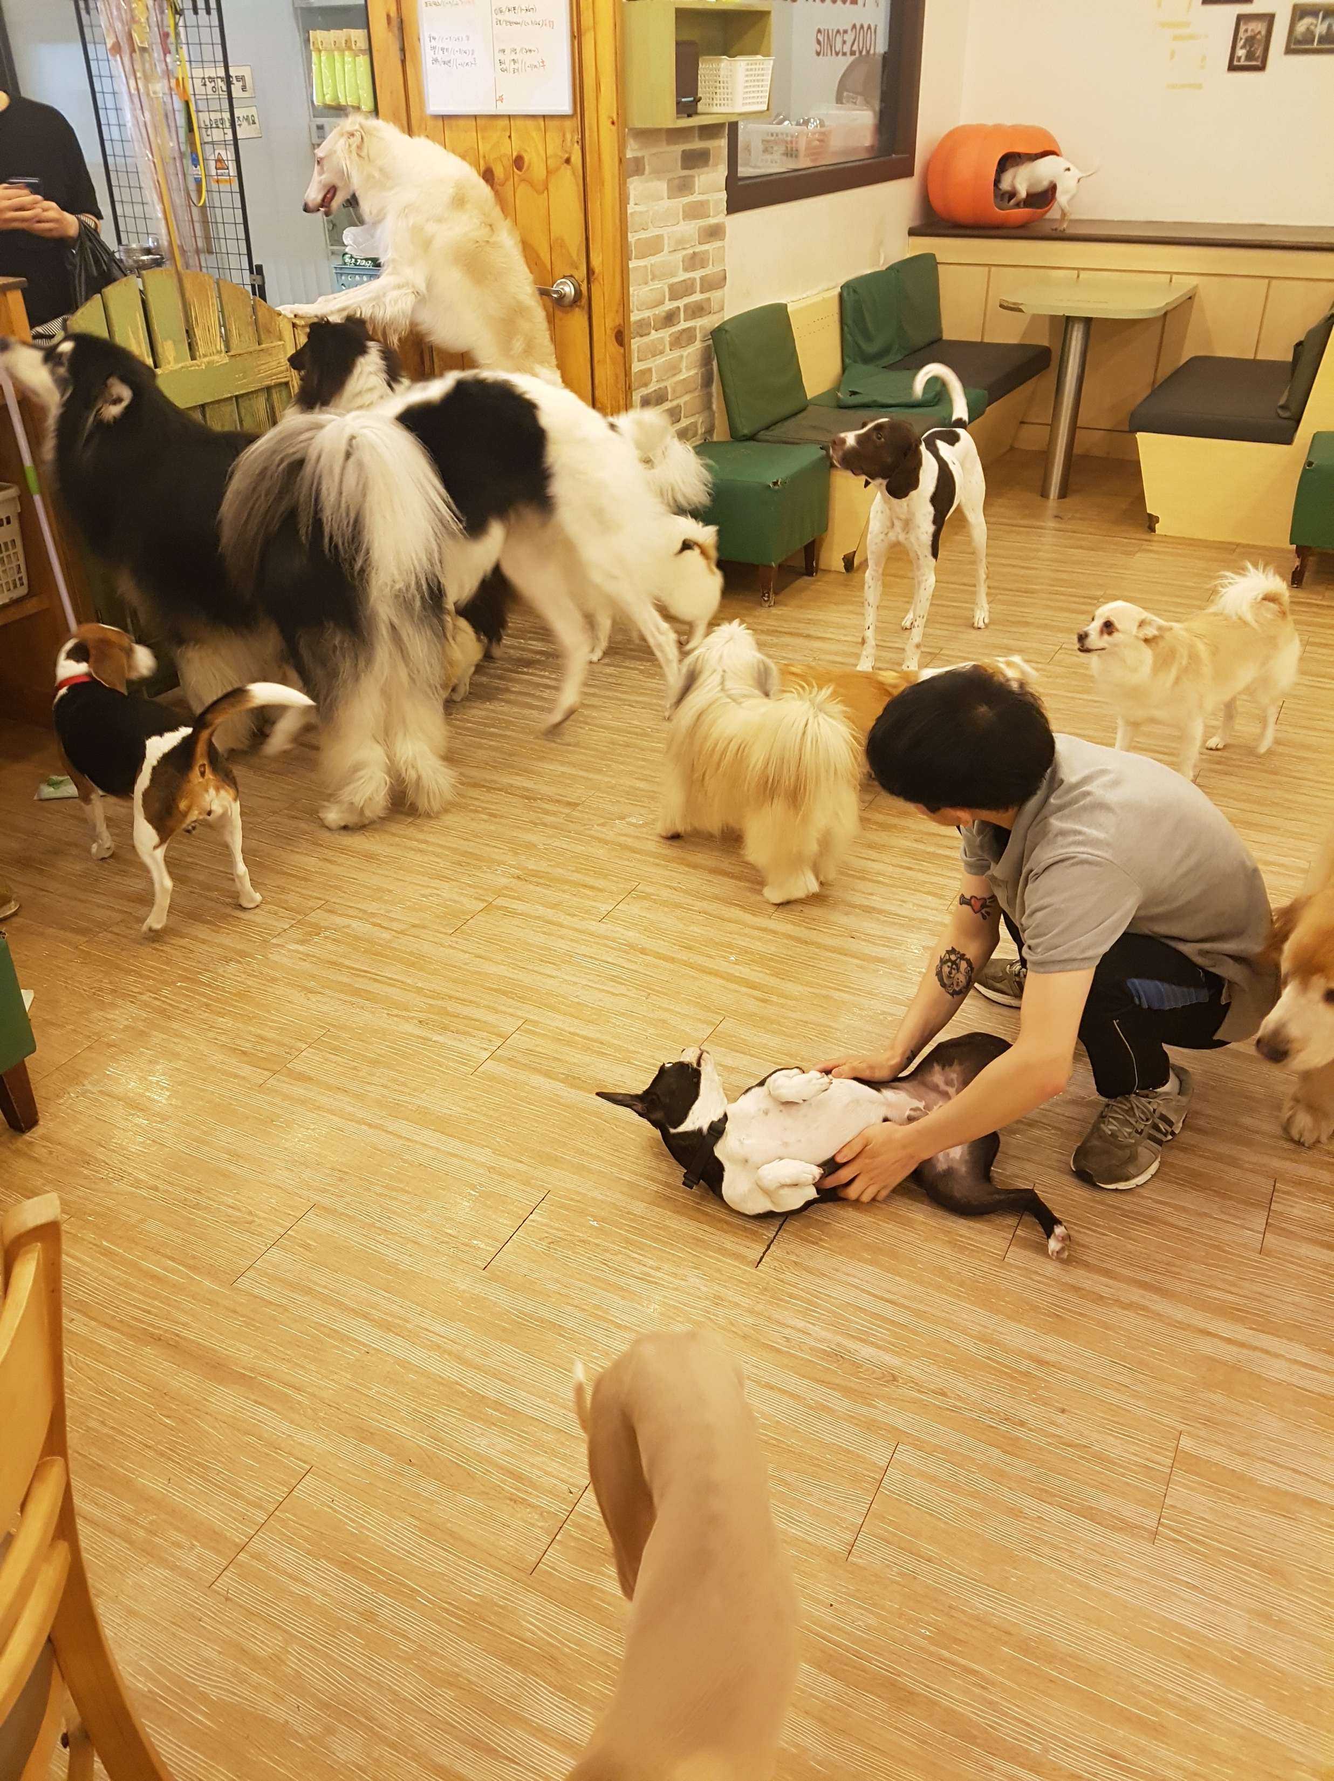
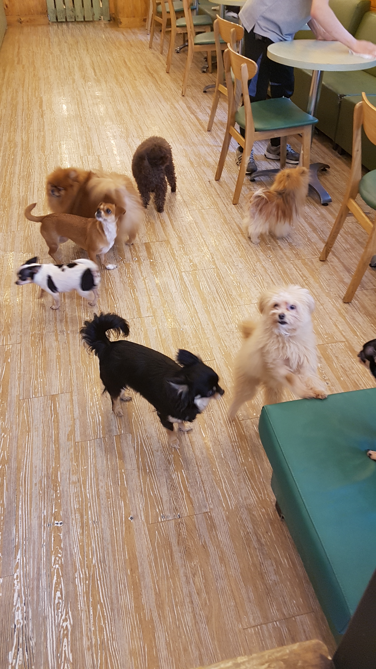
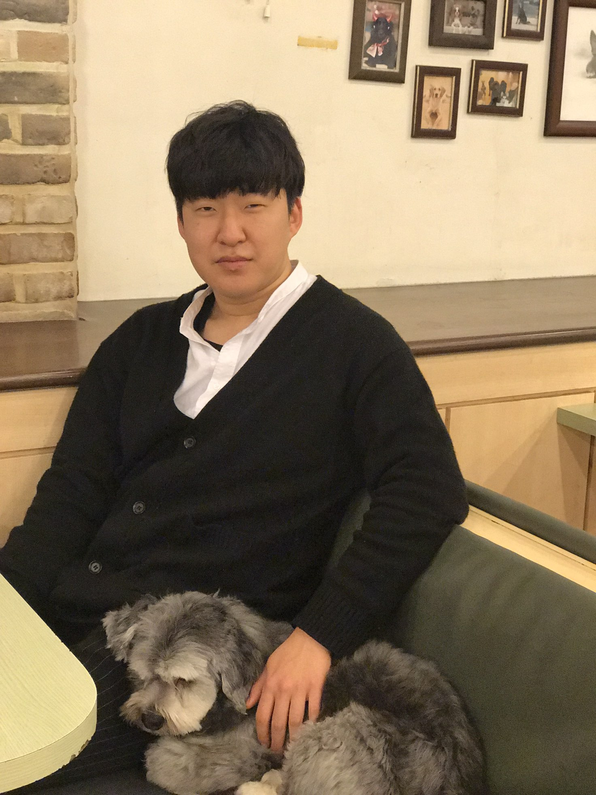
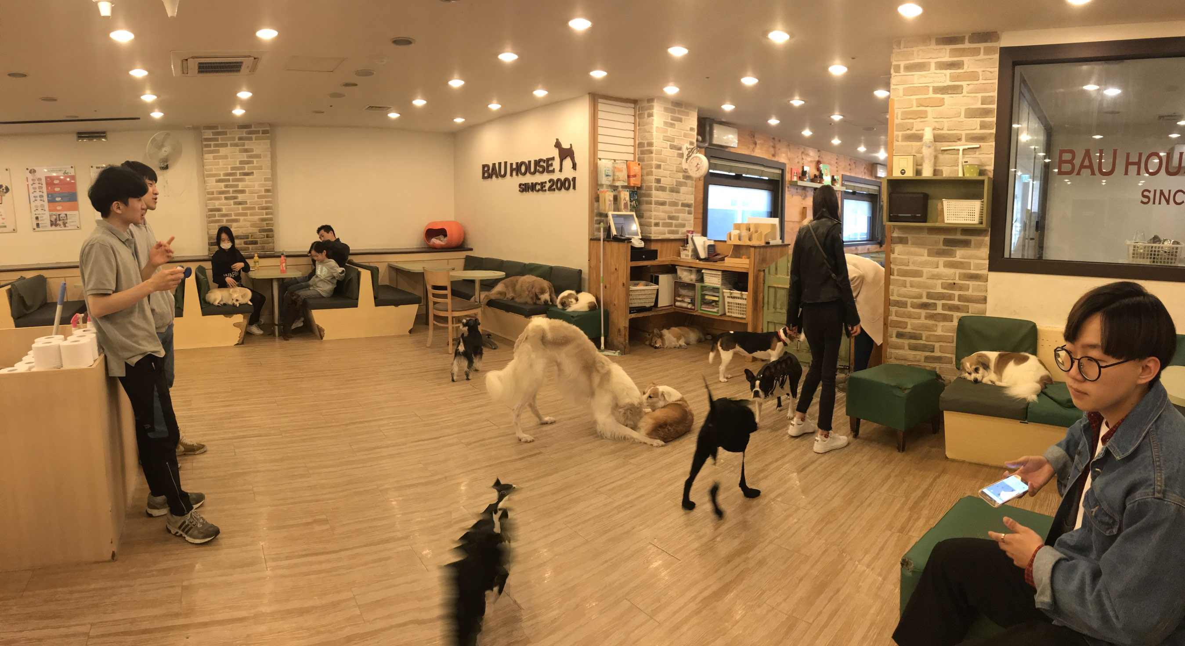
Schedule & Progress – Together
“Workshop for collecting data set( Dog cafe, park, .. etc)”
7
Notes:
This is our schedule for workshop.
We have been to dog cafe near HapJung Station to collect the data of dog nose.

Slide 8
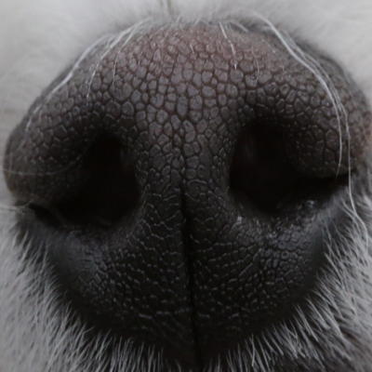
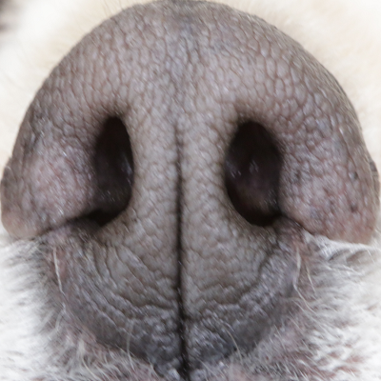
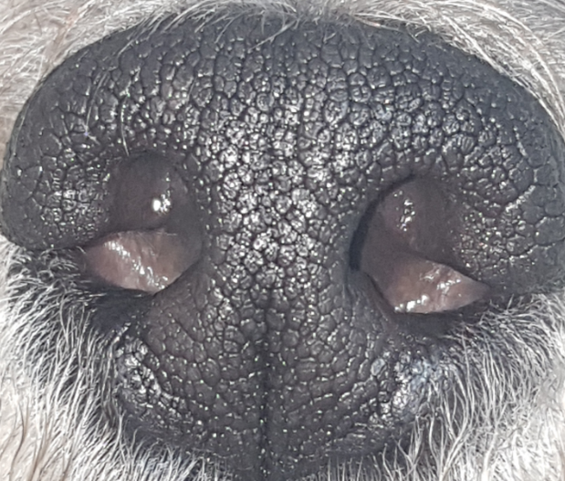
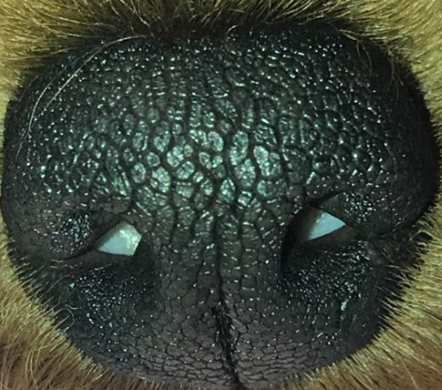
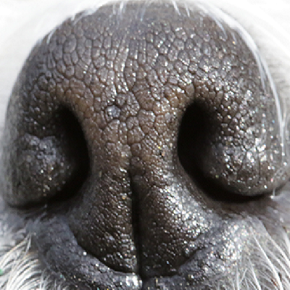
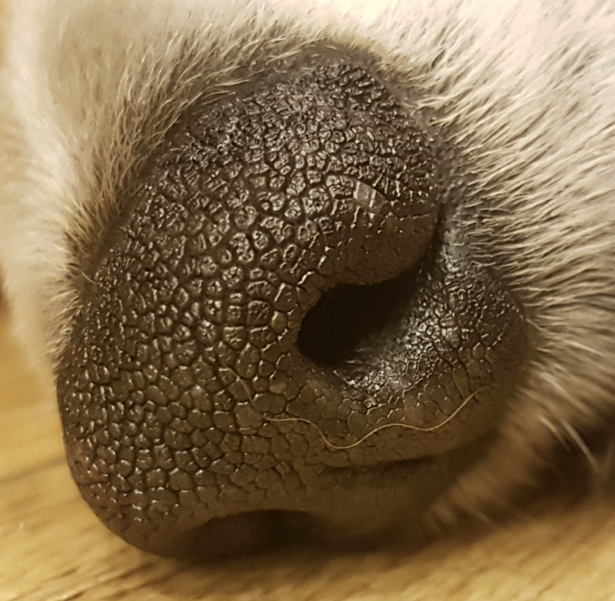
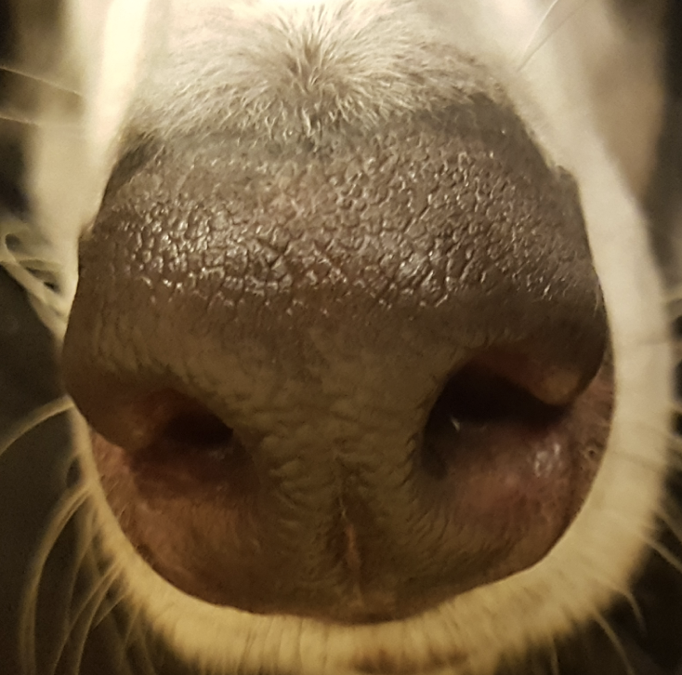
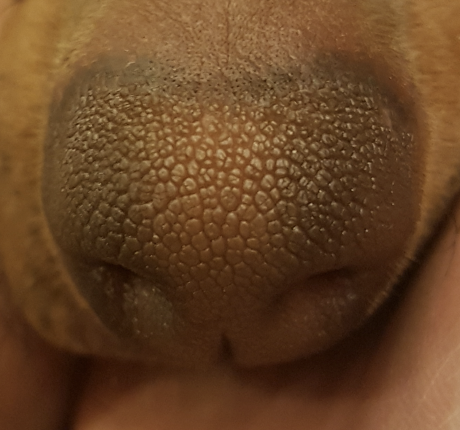
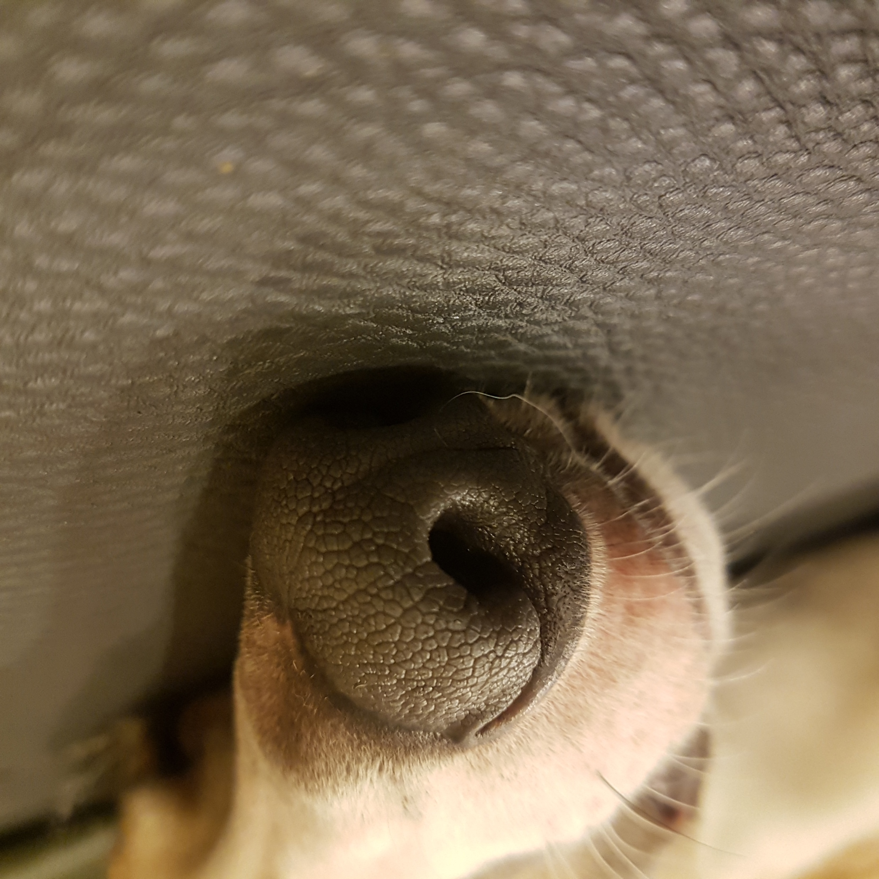
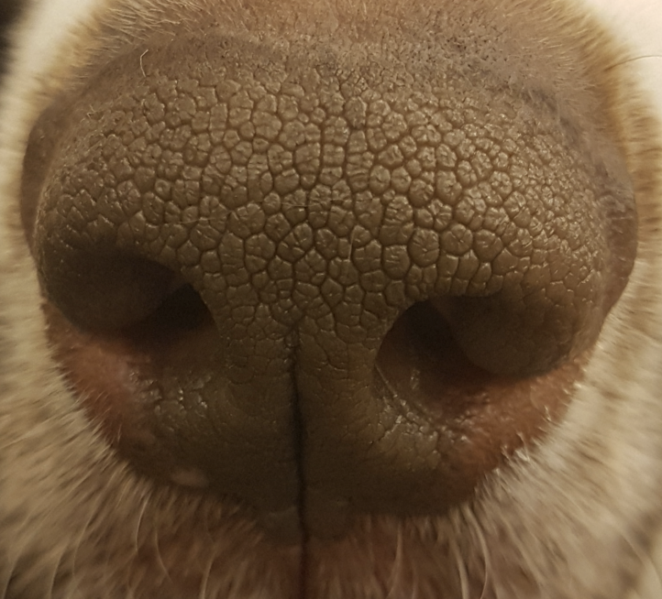
Schedule & Progress – Together
“Workshop for collecting data set( Dog cafe, park, .. etc)”
8
Notes:
This is the data we collected.
As we said before, it will work as a fingerprint in the human side.

Slide 9
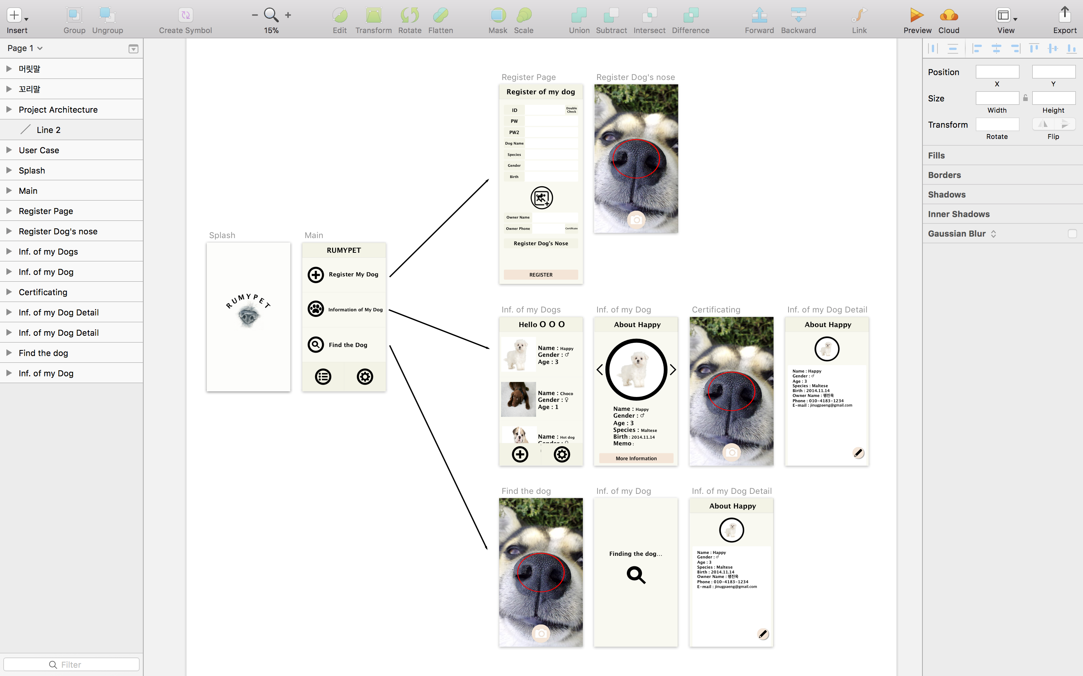
Schedule & Progress – Kim Chan Il
“Apply Design to Android Studio”
↴
Design we have done Last Week!
9
Notes:
This is the UI Deisign we did last week.
Using this, Chan il Kim applied this into Android Studio.

Slide 10
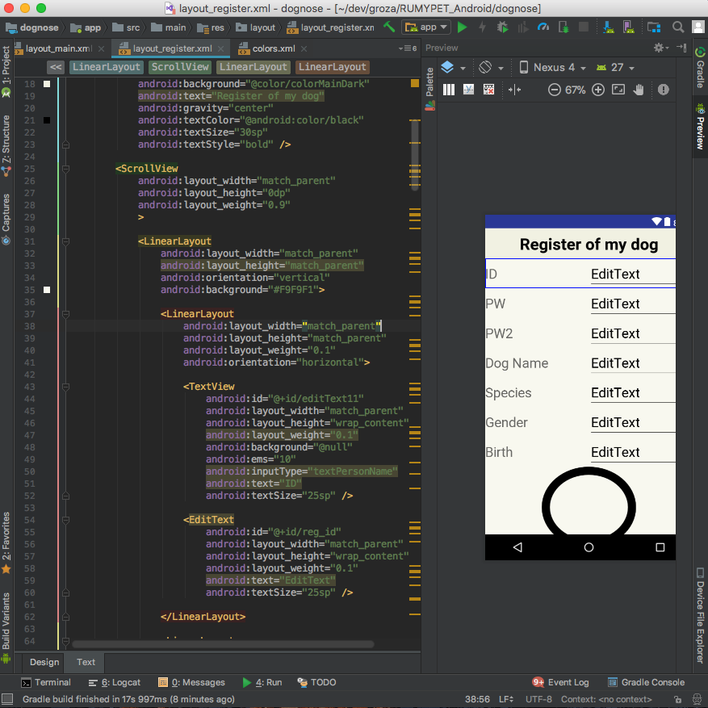
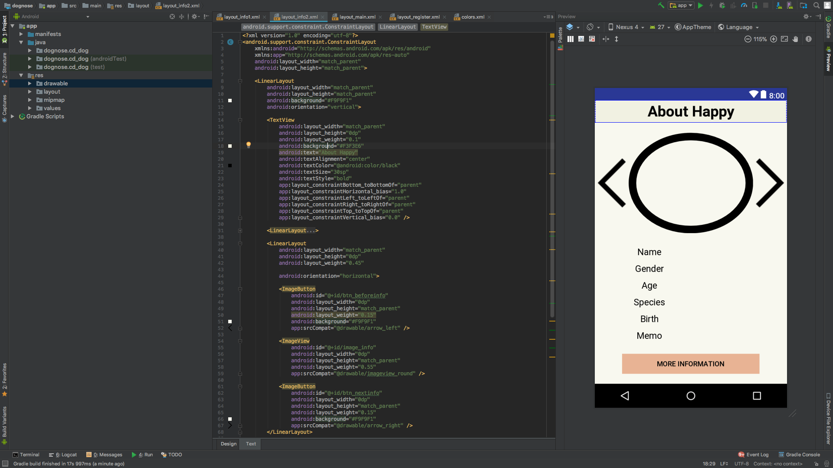
Schedule & Progress – Kim Chan Il
“Apply Design to Android Studio”
10
Notes:
This is what he have done.

Slide 11



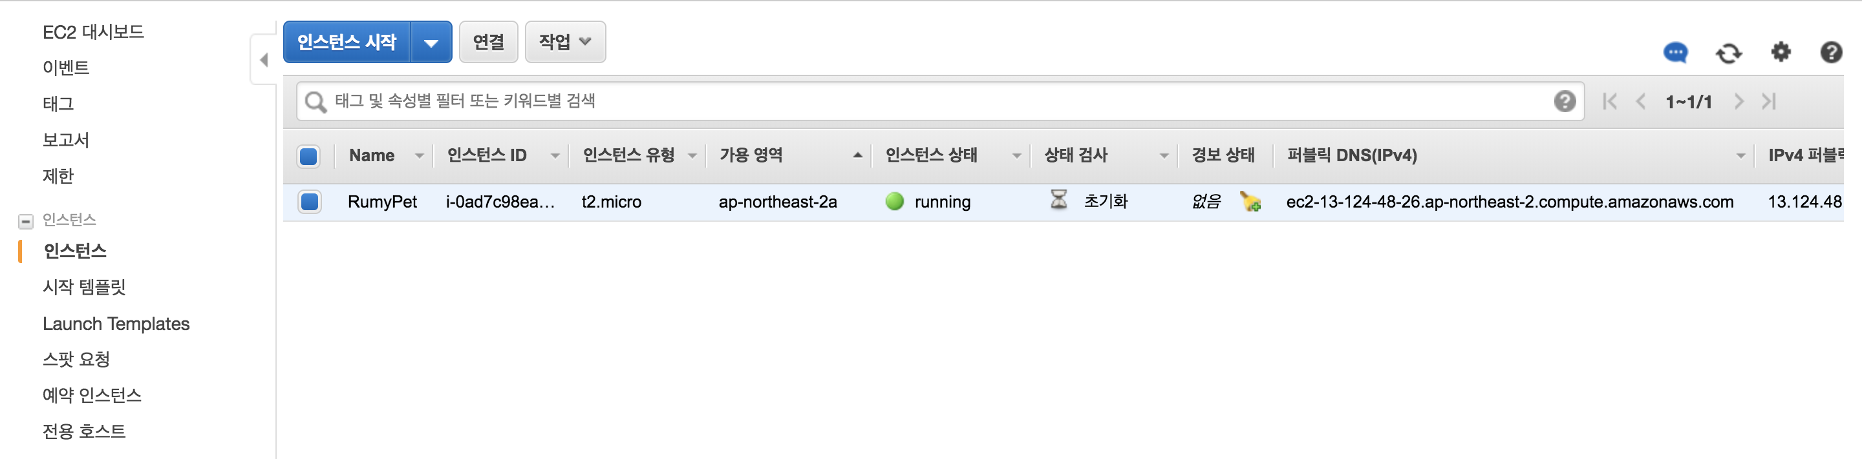
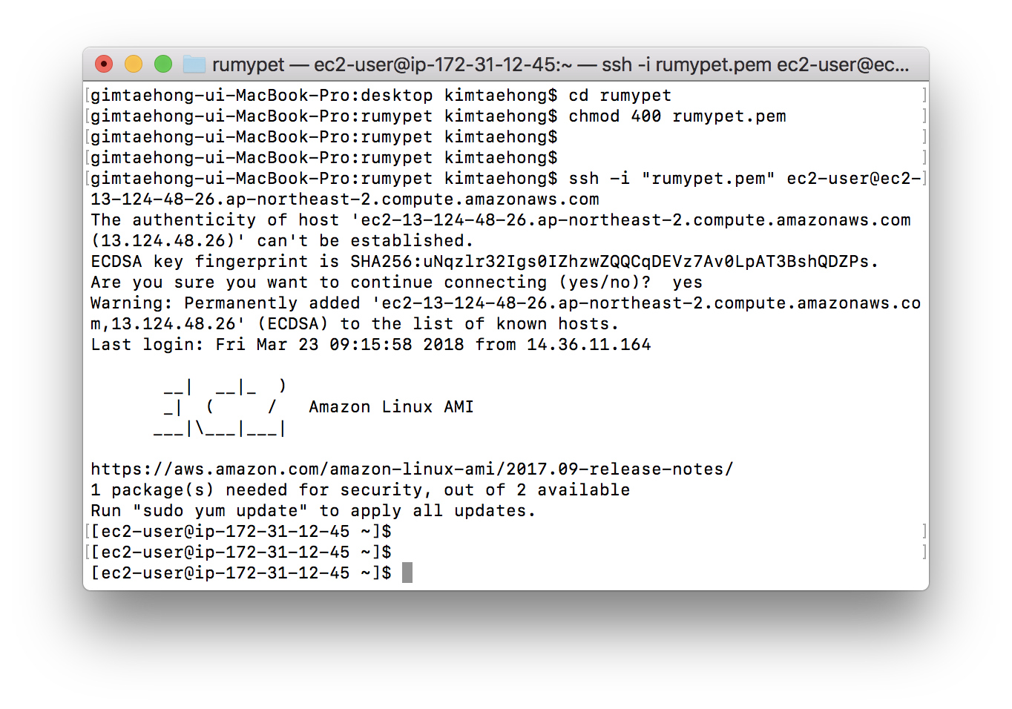
Schedule & Progress – Kim Tae Hong
“Launch Server Using Amazon Web Service”
11
Notes:
Next, Tae hong Kim launched our own cloud server using Amazon web service.
Because we don’t have our server computer.

Slide 12


Schedule & Progress – Paeng Jin Wook
“Develop Pre-processing Method and apply it to Fingerprint picture”
OpenCV Version : 3.4.0
Python Version : 3.6.4
12
Notes:
Next, This is what I have done. I developed pre-processing method and applied it to fingerprint picture.
I used OpenCV – Python, and these are the version of them.
The principle of Fingerprint recognition and Dog Nose Recognition is very Similar.

Slide 13
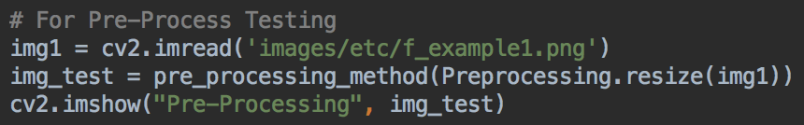
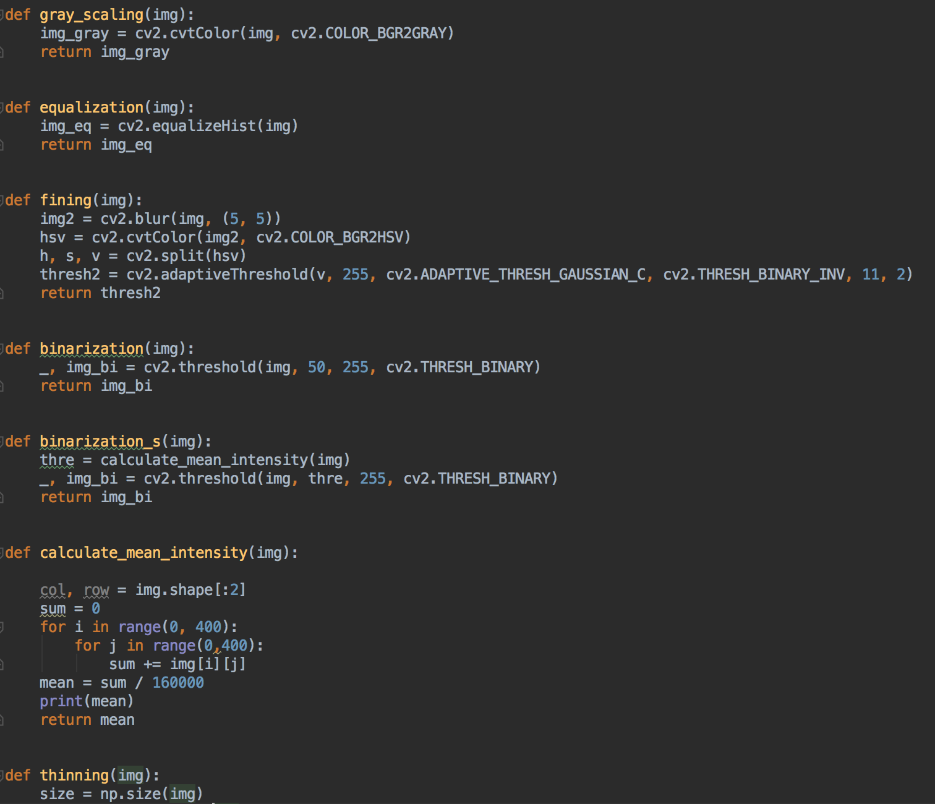
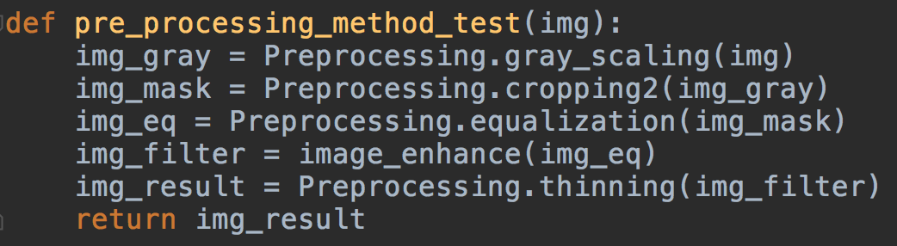
Schedule & Progress – Paeng Jin Wook
“Develop Pre-processing Method and apply it to Fingerprint picture”
Showing GUI
Pre-Processing Process
Gray Scaling
masking
Equalization
Ridge enhance filter
thinning
13
Notes:
In fingerprint recognition, to detect the feature of the fingerprint, the image must go through the process of pre-processing.
This is the Pre-processing stage.
1. 2. ....

Slide 14
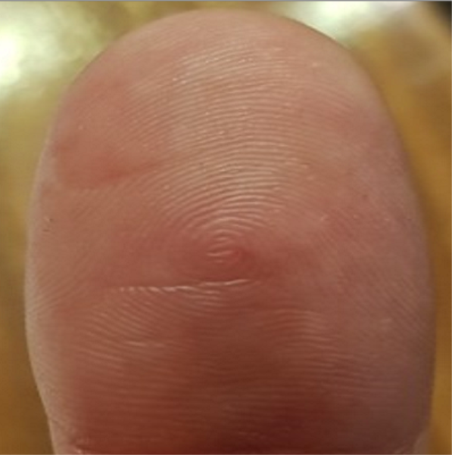
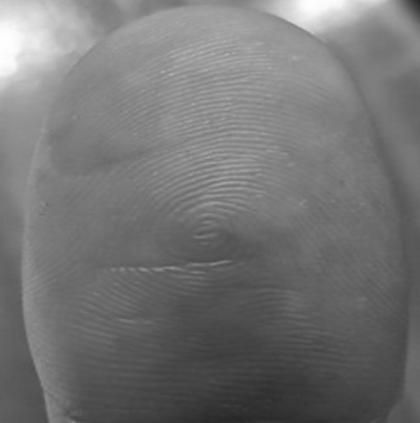
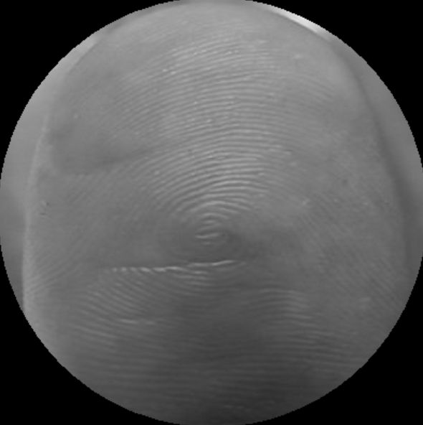
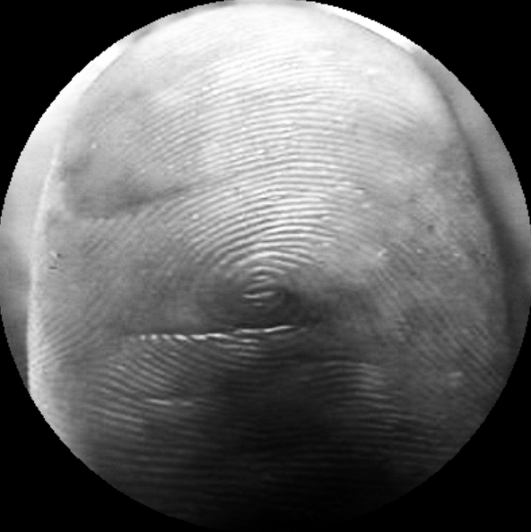
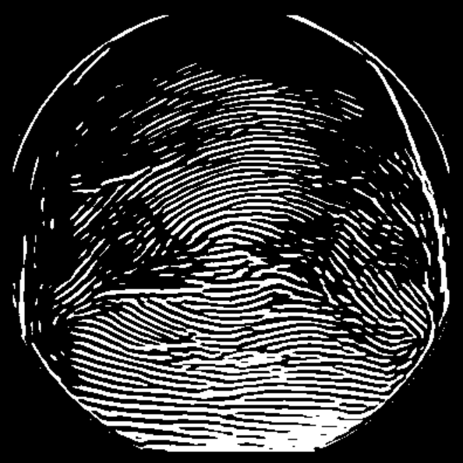
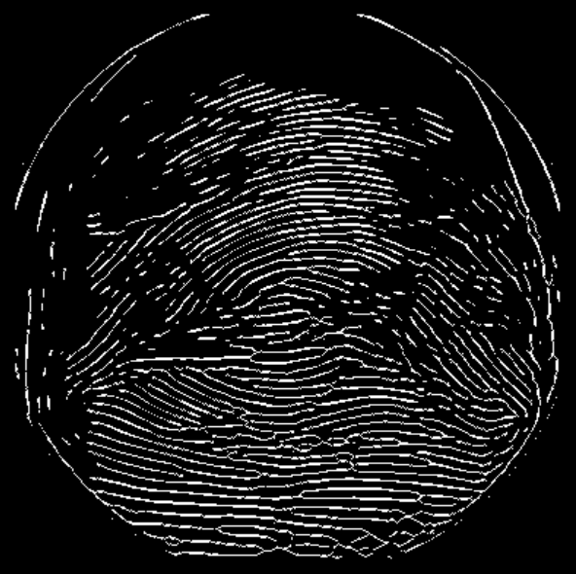
Schedule & Progress – Paeng Jin Wook
“Develop Pre-processing Method and apply it to Fingerprint picture”
Raw image
Gray scale image
masking image
equalized image
Ridge orient image
thinned image
14
Notes:
And these are the result of the image.
Using thinned image, we will going to detect the feature of it, get the matching point, and figure out whether the image is yours or not.
We will apply this process to Dog Nose data that we collected.

Slide 15
2. PROBLEMS & SOLUTION

Slide 16
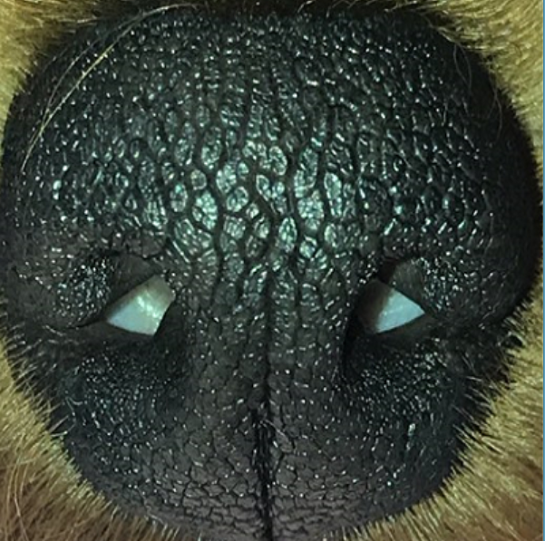
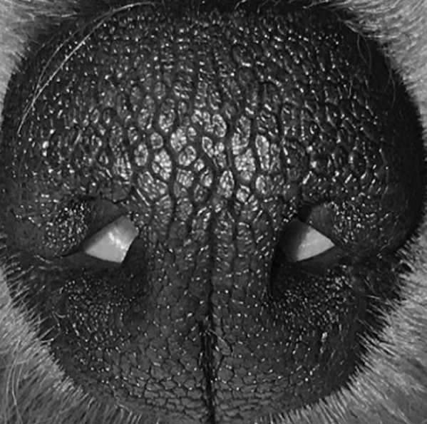
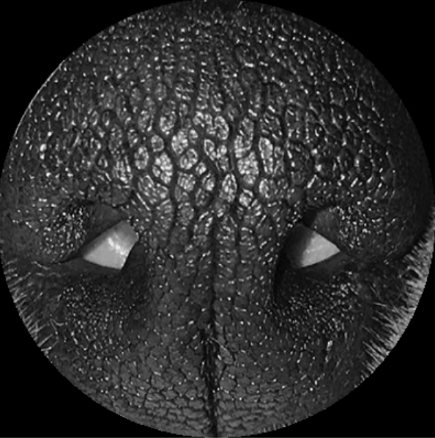
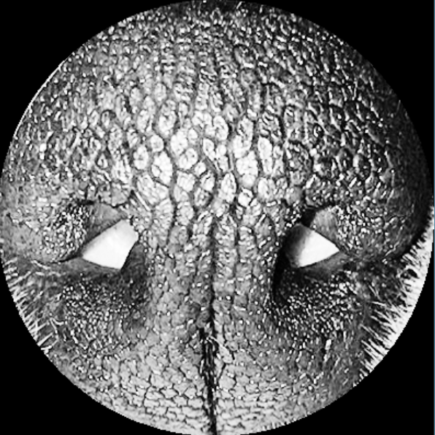
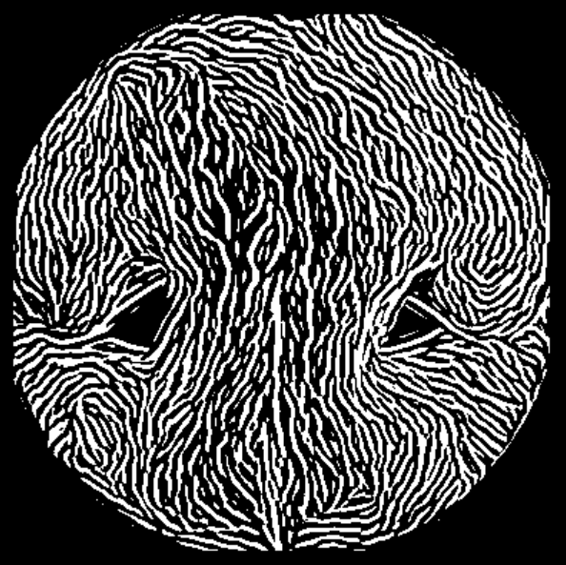
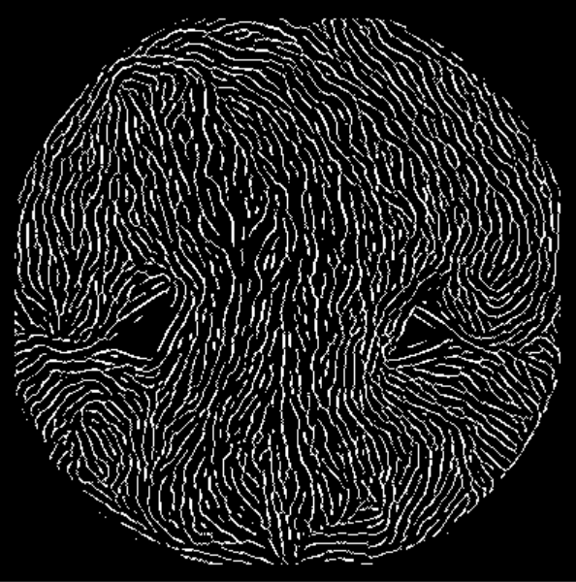
PROBLEMS & SOLUTIONS
Problem 1
We can’t get a good performance with the Preprocessing code of fingerprint.
Raw image
gray image
mask image
Eq image
filter image
thin image
This was the Preprocessing result of Last week
16
Notes:
--ppt reading--
Now, we have our own server!

Slide 17
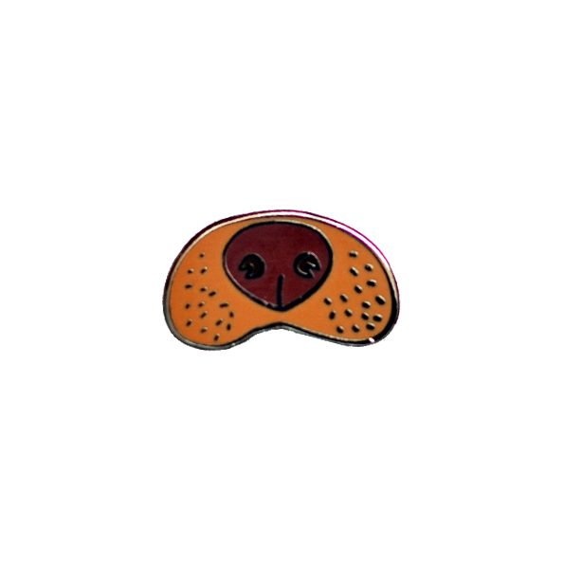

PROBLEMS & SOLUTIONS
Problem
We’re not sure that we can detect the feature of the dog’s nose,
and get the matching score accurately, because there is no example code.
Solution
We give a try with the Fingerprint Recognition Algorithm
because their principles are very similar.
17
Notes:
Preprocessing -> Feature Detecting -> Matcing

Slide 18
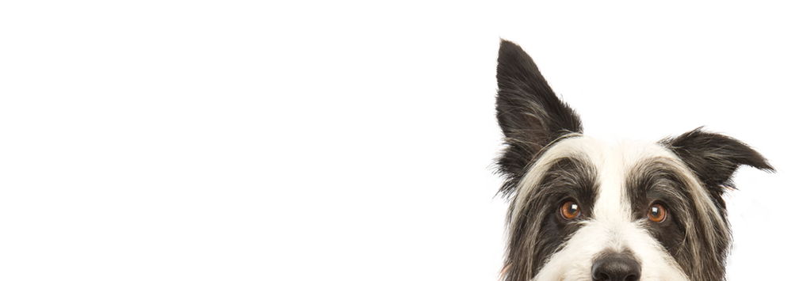
3. PLANS

Slide 19
PLANS for next week
Week 5 | Kim Chan Il : Develop Android Application Kim Tae Hong : Build the basic code in the server (Node JS) Paeng Jin Wook : Apply Pre-processing method to the dog’s nose picture using Python OpenCV
18
Notes:
ppt reading

Slide 20
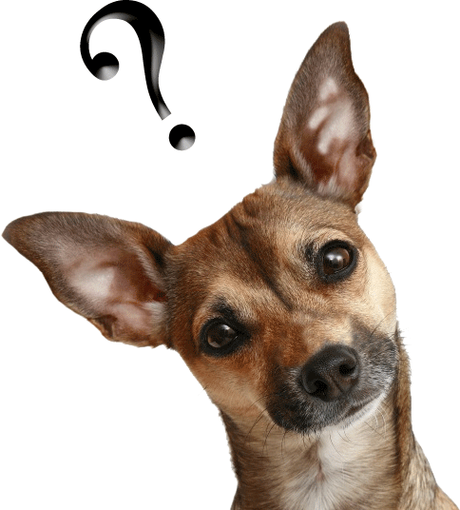
Q&A

Slide 21
Thank you!

